Slide 1
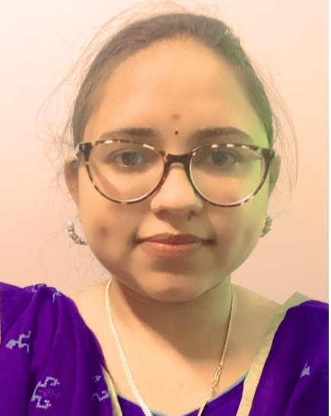



Datha Pooja Vakamalla
Analyst/Software Engineer
Bachelor of Technology
Electronics and Communication Engineering:2017-2021
Skills
Bangalore
C# | C# Basics, OOPS, Generics, Collections, Arrays, Loops,Data Types in C#,delegates;
ASP .NET | ASP .Net Fundamentals, Entity Framework Web API Routing Web API Introduction.
ASP .NET Core | Asp.net core Fundamentals, Building an API with .Net Core, Dependency Injection in ASP.Net Core.
UI Framework-React | Fundamentals components ,Java Script, Working with states & props in React , Event Handling in React , Routing ,Life Cycle Method, Working with HTTP in React.
React | Components, Services, Modules, Routing, Forms & Validation, Testing using Jasmin & Karma
Database | MSSQL Server, basics of SQL
Tools | Visual Studio 2019, Visual Studio code, Swagger, Postman, SSMS.
Add On skills | Communications, Team management. Peer learning
vakamalla-datha.pooja@capgemini.com
+91 7989388008
A4
Proficient in C# and OOPs concepts.
Hands on experience in creating Web Application with ASP.NET , .NET Core, Web API, React.
Practical Understanding of Query Language Like LINQ
Hands on experience in developing web pages using HTML5, CSS3, Object Oriented Programming, JSON, XML. Good understanding of Document Object Model (DOM) and DOM Functions.
Practical understanding of rendering ASP.NET Web Forms, MVC Razor, REST API.
Proficient React developer with working knowledge on React.
Implemented Web API and React in case study and up skilling this knowledge continuously.
E-commerce Farming Application
Working on end to end case study of E-commerce Farming Application along with authentication, Swagger and React used for user interface.
.NET and React for web developers in Degreed Platform
Completed this course with optimal Knowledge of MVC ,Web API , RESTful services , Components.
Online Shopping Application
Developed Online Shopping using Frontend react and Backend .NET core Web API with SSMS as Database .
Check out my work on GitHub and video profile
&
AZ-900

